Slide 1
The Pope and the Khan

Slide 2
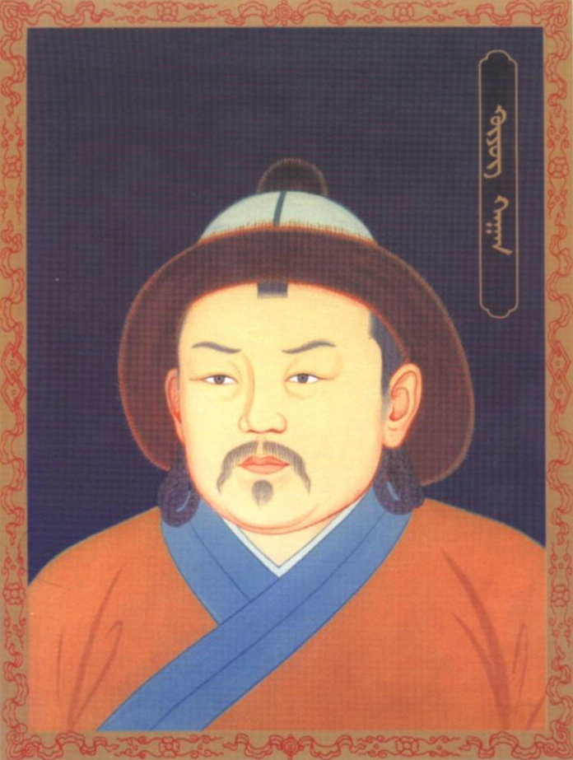
Güyük Khan
(r. 1246 - 1247)
3rd Great Khan

Slide 3
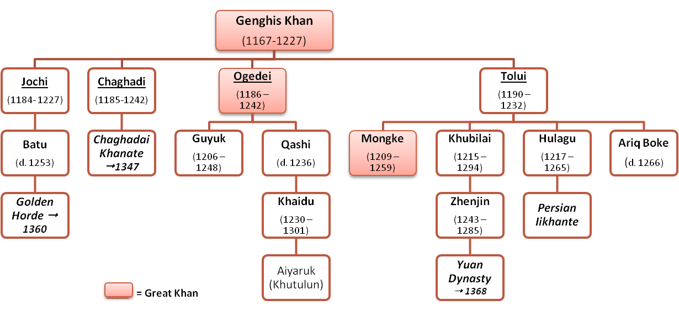
Genghis Khan
Family Tree

Slide 4
Güyük Khan
(r. 1246 - 1247)
3rd Great Khan

Slide 5
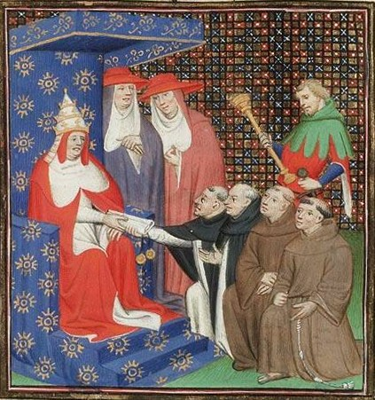
Innocent IV’s Embassy to the Mongols
Vincent of Beauvais, Le Miroir Historial
Paris, c. 1400-1410

Slide 6
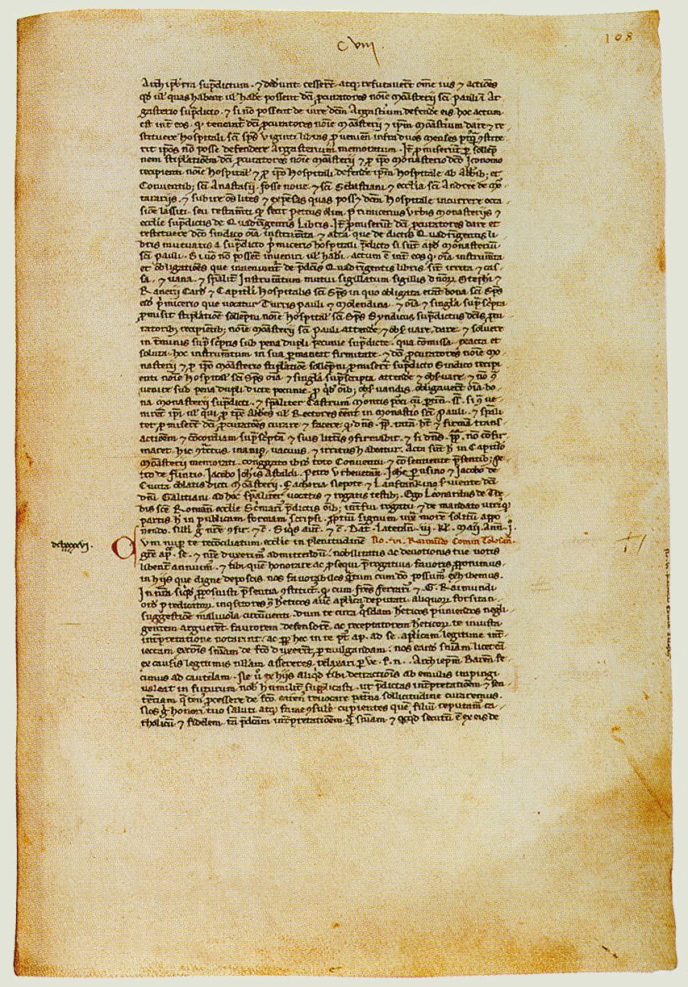
Innocent IV’s Letter
We, therefore, following the example of the King of Peace, and desiring that all men should live united in concord in the fear of God, do admonish, beg and earnestly beseech all of you that for the future you desist entirely from assaults of this kind and especially from the persecution of Christians, and that after so many and such grievous offenses you conciliate by a fitting penance the wrath of Divine Majesty, which without doubt you have seriously aroused by such provocation; nor should you be emboldened to commit further savagery by the fact that when the sword of your might has raged against other men Almighty God has up to the present allowed various nations to fall before your face; for sometimes He refrains from chastising the proud in this world for the moment, for this reason, that if they neglect to humble themselves of their own accord He may not only no longer put off the punishment of their wickedness in this life but may also take greater vengeance in the world to come.
Vatican Secret Archives, Vatican City
Inv. no. Reg. Vat., 21, ff. 107 v. – 108 r.

Slide 7
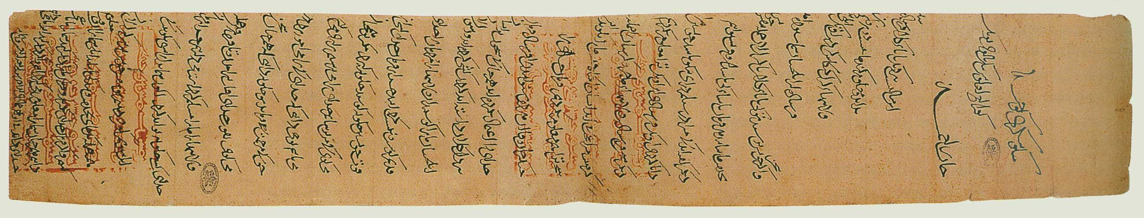
Güyük’s Reply
Through the power of God, all empires from the rising of the sun to its setting have been given to us and we own them. How could anyone achieve anything except by God’s order? Now, however, you must say with a sincere heart: “We shall be obedient, we, too, make our strength available.” You personally, at the head of the Kings, you shall come, one and all, to pay homage to me and to serve me. Then we shall take note of your submission. If, however, you do not accept God’s order and act against our command, we shall know that you are our enemies.
This is what we make known to you. If you act against it, how then can we know what will happen? Only God knows.
Vatican Secret Archives, Vatican City
Inv. no. A. A., Arm. I-XVIII

